Slide 1
Employee Data Analysis using Excel
STUDENT NAME: VASANTHI T
REGISTER NO: 122204077
DEPARTMENT: B. COM (CORPORATE SECRETARYSHIP)
COLLEGE: SHRI KRISHNASWAMY COLLEGE FOR WOMEN

Slide 2
PROJECT TITLE
EMPLOYEE GENDER ANALYSIS USING EXCEL

Slide 3


AGENDA
Problem Statement
Project Overview
End Users
Our Solution and Proposition
Dataset Description
Modelling Approach
Results and Discussion
Conclusion
3/21/2024 Annual Review

Slide 4

PROBLEM STATEMENT
Consolidate employee data from various sources into a single spreadsheet.
2. Analyze the gender distribution across different departments, roles, and levels.
3. Identify gender disparities in hiring, promotion, and retention rates.
4. Visualize the findings using charts, graphs, and dashboards to facilitate easy understanding and decision-making.

Slide 5

PROJECT OVERVIEW
- Consolidate employee data from various sources into a single Excel spreadsheet - Analyze gender distribution across: - Departments - Roles - Levels (junior, mid-level, senior) - Examine gender disparities in: - Hiring rates - Promotion rates - Retention rates - Visualize findings using Excel charts, graphs, and dashboards

Slide 6

WHO ARE THE END USERS?
1. Diversity and Inclusion Team: Team members responsible for promoting diversity, equity, and inclusion within the organization, who require data-driven insights to develop effective programs and policies.
2. Management and Leadership: CEOs, CFOs, department heads, and other senior leaders who need to understand gender diversity trends and gaps to make informed decisions about talent management, succession planning, and organizational development.
3. Compliance and Regulatory Teams: Teams responsible for ensuring compliance with anti-discrimination laws and regulations, who require data to demonstrate adherence to equal employment opportunity principles.

Slide 7

OUR SOLUTION AND ITS VALUE PROPOSITION
Solution: Employee Gender Analysis using Excel is a comprehensive solution that enables organizations to track, analyze, and visualize gender diversity metrics, identify disparities, and inform data-driven decisions to promote inclusivity and equity.
Value Proposition:
Data-Driven Insights: Unlock actionable insights on gender diversity, enabling informed decisions to address disparities and promote inclusivity.
2. Efficient Analysis: Streamline gender diversity analysis using Excel, saving time and resources.
3. Identify Disparities: Detect gender disparities in hiring, promotion, and retention rates, enabling targeted initiatives.

Slide 8
Dataset Description
Employees Gender
Employees Date Of Joining
Employees Age

Slide 9

THE "WOW" IN OUR SOLUTION
Interactive Dashboards: Create dynamic, interactive dashboards that allow users to explore gender diversity metrics in real-time.
Predictive Analytics: Integrate predictive models to forecast future gender diversity trends and identify potential disparities.
Automated Reporting: Develop automated reporting features that generate regular gender diversity reports, saving time and effort.
Customizable Visualizations: Offer customizable visualization options, enabling users to tailor reports to their specific need.
3/21/2024 Annual Review
9

Slide 10
MODELLING
Data Input: - Employee data (gender, department, role, hire date, promotion date, etc.) - HR data (hiring rates, promotion rates, retention rates, etc.).
Data Cleaning and Processing: - Data validation and error handling - Data transformation (e.g., converting text to numerical values).
Gender Distribution Analysis: - Calculating gender ratios across departments, roles, and levels - Creating pivot tables to summarize data.
4. Gender Disparity Analysis: - Calculating hiring, promotion, and retention rates by gender - Identifying disparities using statistical methods (e.g., z-scores, t-tests).
10

Slide 11
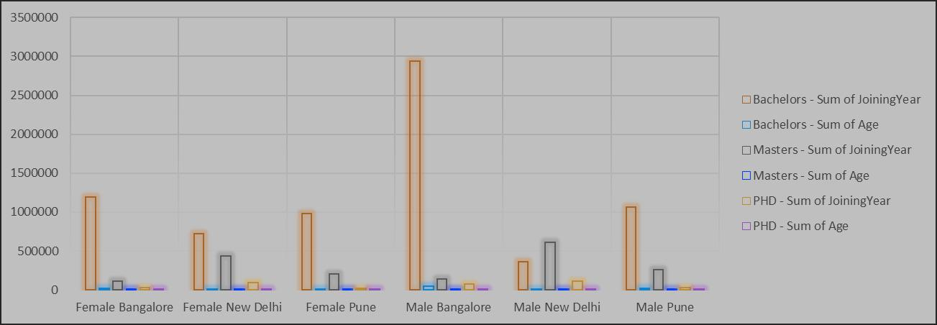
RESULTS
11

Slide 12
conclusion
The Employee Gender Analysis using Excel has provided valuable insights into the gender diversity .
The analysis revealed:-
Gender disparities in hiring, promotion, and retention rates
Underrepresentation of women in senior roles and certain departments
Opportunities for improvement in gender diversity and inclusion initiatives

